Slide 1
Statistical Analysis- Basics

Slide 2
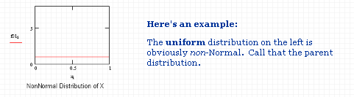
Central Limit Theorem
The distribution of an average will tend to be Normal as the sample size increases, regardless of the distribution from which the average is taken except when the moments of the parent distribution do not exist.
Thus, the Central Limit theorem is the foundation for many statistical procedures, including Quality Control Charts, because the distribution of the phenomenon under study does not have to be Normal because its average will be.

Slide 3
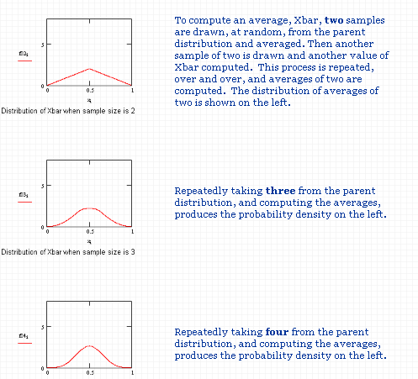
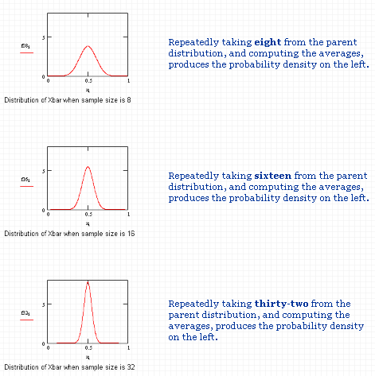
Central Limit Theorem cont…

Slide 4
Discrete Random Variable
Expected Value (i.e., Mean) of a Discrete Random Variable
Law of Large Numbers: Given a large number of repeated trials, the average of the results will be approximately equal to the expected value
Expected value: The mean value in the long run for many repeated samples, symbolized as E(X)
Expected Value for a Discrete Random Variable
E(X)=∑x_{i}p_{i}
x_{i}= value of the i^{th} outcome
p_{i} = probability of the i^{th} outcome
Example :
A fair six-sided die is tossed : You win $2 if the result is a “1,”
You win $1 if the result is a “6,”
but otherwise you lose $1.
The interpretation is that if you play many times, the average outcome is losing 17 cents per play. Thus, over time you should expect to lose money.

Slide 5
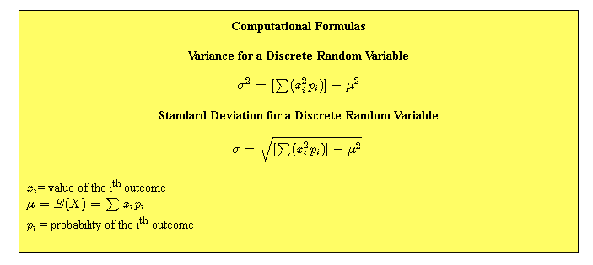
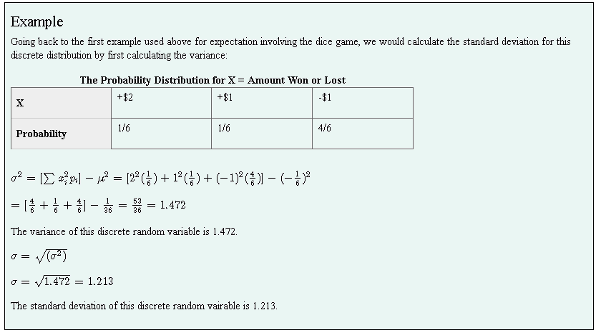
Standard Deviation of a Discrete Random Variable
It is also important to know the spread, or variability, of these data.
For instance, you may "expect" to win $20 when playing a particular game (which appears good!), but the spread for this might be from losing $20 to winning $60. Knowing such information can influence you decision on whether to play.
Conceptually, the variance of a discrete random variable is the sum of the difference between each value and the mean times the probability of obtaining that value.

Slide 6
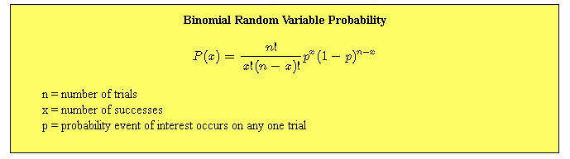
Binomial Random Variables
For a variable to be a binomial random variable, ALL of the following conditions must be met:
There are a fixed number of trials (a fixed sample size)
On each trial, the event of interest either occurs or does not
The probability of occurrence (or not) is the same on each trial
Trials are independent of one another
Examples of Binomial Random Variables
Number of correct guesses at 30 true-false questions when you randomly guess all answers
Number of winning lottery tickets when you buy 10 tickets of the same kind
Number of left-handers in a randomly selected sample of 100 unrelated people
Number of tails when flipping a coin 10 times

Slide 7
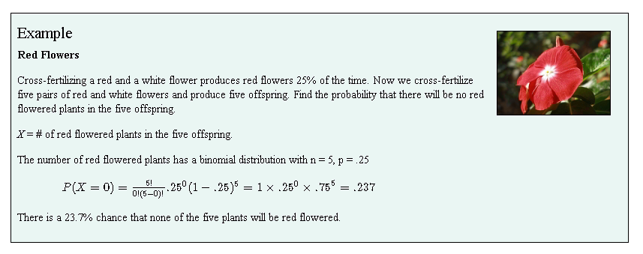
Binomial Distribution

Slide 8
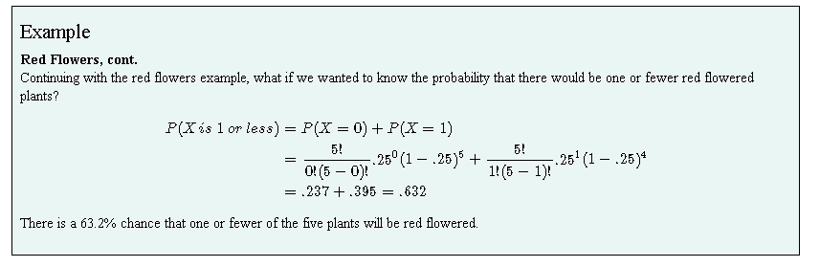
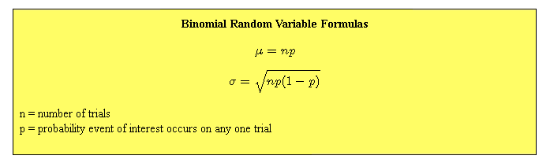
Cumulative probability
Cumulative probability: Likelihood that a certain number of successes or fewer will occur.
Binomial random variable probabilities are mutually exclusive, therefore we can use the addition rule.

Slide 9
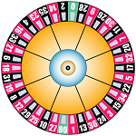
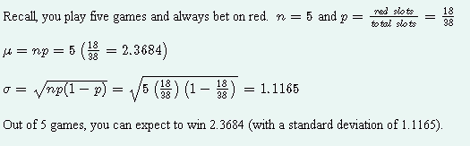
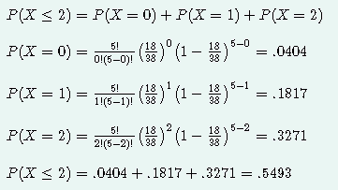
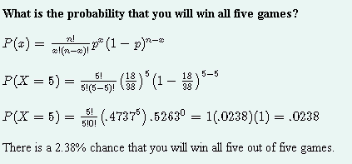
Example
A roulette wheel has 38 slots, 18 are red, 18 are black, and 2 are green. You play five games and always bet on red.
How many games can you expect to win?
If you win three or more games, you make a profit. If you win two or fewer games, you lose money. What is the probability that you will win no more than two games?
There is a 54.93% chance that you will win no more than two games. In other words, there is a 54.93% chance that you will lose money.

Slide 10
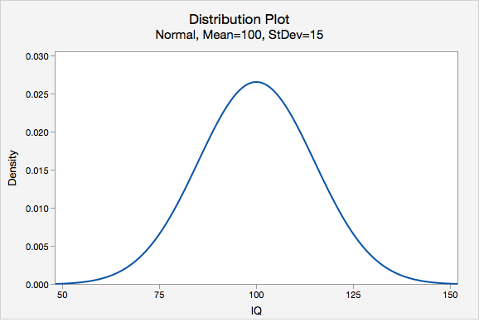
Continuous Random Variable
A continuous random variable has an infinite number of possible values, so we can't assign probabilities to each specific value. If we did, the total probability would be infinite, rather than 1, as it is supposed to be.
To describe probabilities for a continuous random variable, we use a probability density function.
Probability density function (PDF): A curve such that the area under the curve within any interval of values along the horizontal gives the probability for that interval
Normal Random Variables
The most commonly encountered type of continuous random variable is a normal random variable , which has a symmetric bell-shaped density function.
The centre point of the distribution is the mean value, denoted by μ ("mu").
The spread of the distribution is determined by the variance, denoted by σ²("sigma squared") or by the square root of the variance called standard deviation, denoted by σ ("sigma").

Slide 11
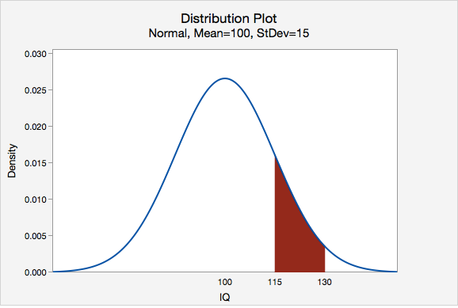
Following figure shows the probability that the IQ of a randomly selected individual will be between 115 and 130. This probability is equal to the shaded area under the curve between 115 and 130.

Slide 12
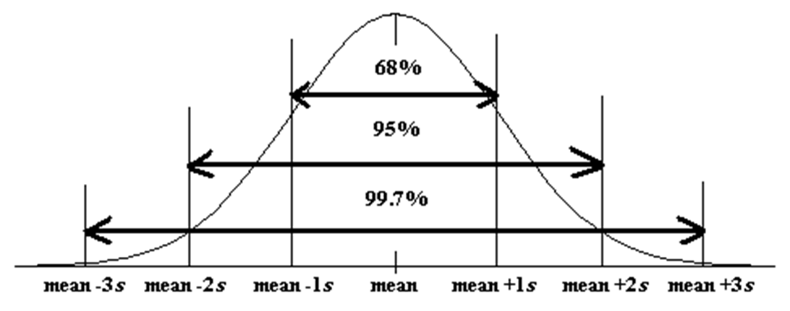
Empirical Rule Review
The Empirical Rule can be used to estimate the proportion of observations that should fall within the intervals of one, two, and three standard deviations of the mean:
Middle 68% of observations: μ±1(σ)
Middle 95% of observations: μ±2(σ)
Middle 99.7% of observations: μ±3(σ)

Slide 13

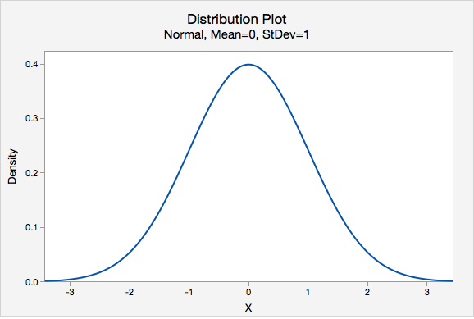
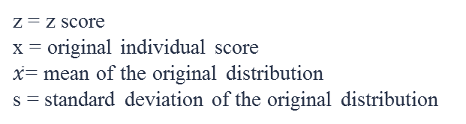
z Scores
When we want to describe one observation in relation to the distribution of all observations. We can do this using a z score.
z score: Distance between an individual score and the mean in standard deviation units; also known as a standardized score.
z distribution: bell-shaped distribution with a mean of 0 and standard deviation of 1, also known as the normal distribution
z = z score
x = original individual score
$\overline{x}$= mean of the original distribution
s = standard deviation of the original distribution

Slide 14
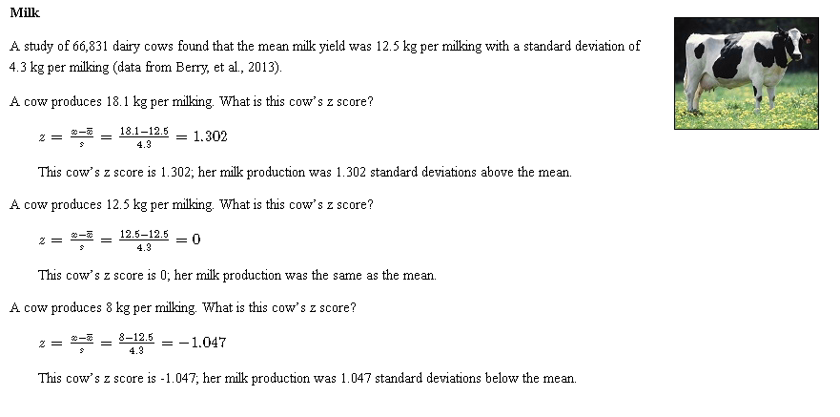
Z score- example

Slide 15
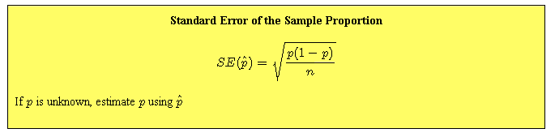
Rule of Sample Proportions
Rule of Sample Proportions (Normal Approximation Method)
If samples of the same size (n) are repeatedly randomly drawn from a population, and the proportion of successes in each sample is recorded (pˆ), the distribution of the sample proportions (i.e., the sampling distribution) can be approximated by a normal distribution given that both n × p ≥ 10 and n×(1−p) ≥ 10.
This is known as the Rule of Sample Proportions. Note that some textbooks use a minimum of 15 instead of 10.

Slide 16
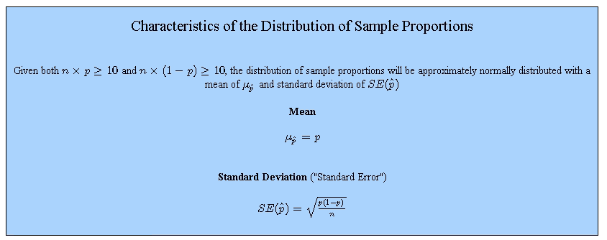
Rule of Sample Proportions

Slide 17
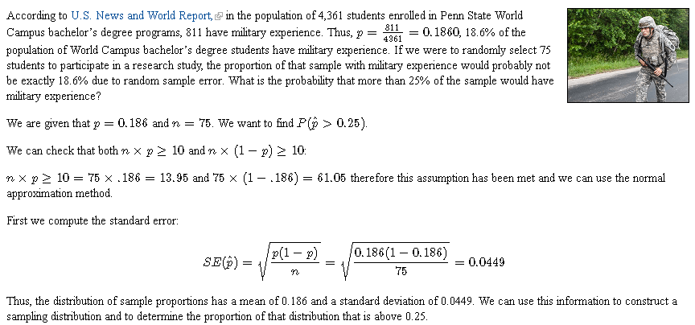
Example

Slide 18
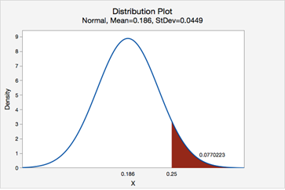
Example
P(pˆ>0.25)=0.0770223
Given that the population proportion is 0.186, the probability of taking a random sample of n=75n=75 and finding a sample proportion of 0.25 or higher is 0.0770223.

Slide 19
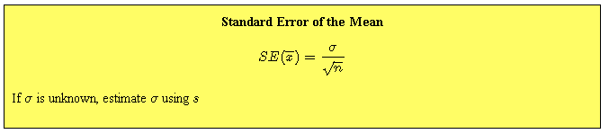
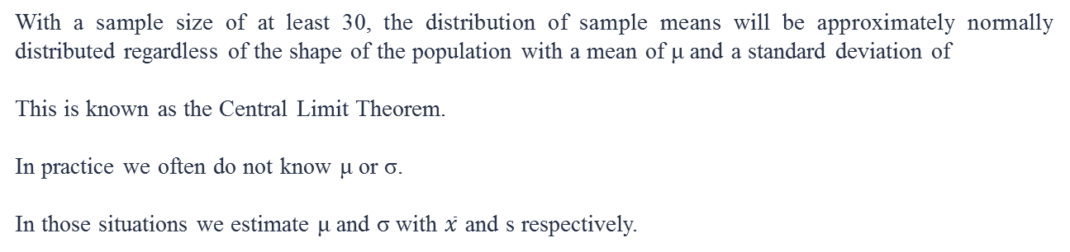
Central Limit Theorem
With a sample size of at least 30, the distribution of sample means will be approximately normally distributed regardless of the shape of the population with a mean of μ and a standard deviation of
This is known as the Central Limit Theorem.
In practice we often do not know μ or σ.
In those situations we estimate μ and σ with $\overline{x}$ and s respectively.

Slide 20
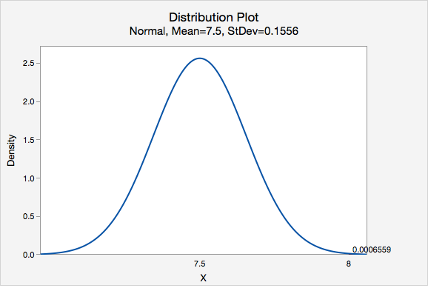
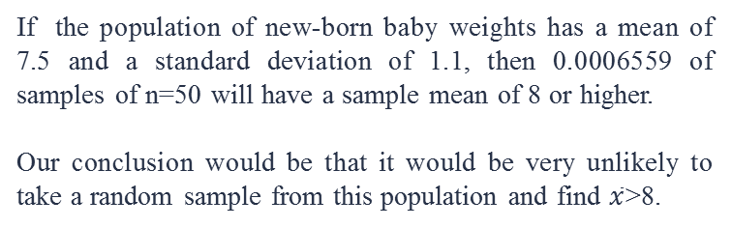
Example 1
According to one source, new-born baby weights have a mean of 7.5 pounds with a standard deviation of 1.1 pounds. If these numbers are accurate, what proportion of samples of n=50 would have a sample mean greater than 8 pounds?
We are not given information about the shape of the population, however n≥30 therefore we can apply the Central Limit Theorem.
The distribution of sample means will have a mean of 7.5 and a standard deviation of
0.1556.
If the population of new-born baby weights has a mean of 7.5 and a standard deviation of 1.1, then 0.0006559 of samples of n=50 will have a sample mean of 8 or higher.
Our conclusion would be that it would be very unlikely to take a random sample from this population and find $\overline{x}$>8.

Slide 21

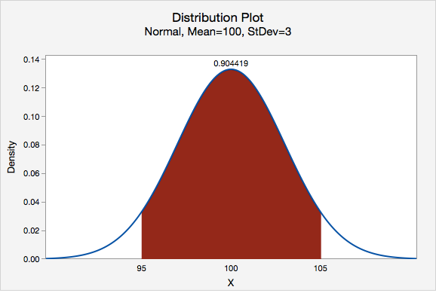
Example 2
In the population, IQ scores are normally distributed with a mean of 100 and standard deviation of 15. If we repeatedly pulled random samples of 25 individuals from the population and measured their IQ, what proportion of those samples would we expect to have a sample mean between 95 and 105?
The distribution of sample means will have a mean of 100 (same as μμ) and standard deviation of
because we know that the original population is normally distributed, we do not need to worry that n<30.
Given that μ=100, σ=15 and n=25, the distribution of sample means will have a mean of 100 and standard deviation (i.e., standard error) of 3. The proportion of sample means ($\overline{x}$s) that fall between 95 and 105 is 0.904419.

Slide 22
Statistical Inference
Two ways of collecting data are sampling and experimentation, both of which employ randomization. One important aspect of randomization is to control bias.
Because chance governs our selection (think of guessing whether a flip of a fair coin will produce a head or a tail) we can make use of probability laws – the scientific study of random behavior – to draw conclusions about an entire population from which the subjects originated. This is called statistical inference.
Parameters and Statistics as they are a major component of statistical inference:
Parameter : a number that describes a population
Statistic : a number that describes a sample
Parameters are fixed values, but we rarely know them because it is often difficult to obtain measures from the entire population.
Statistics are known values computed from a sample; they are random variables because they differ from sample to sample.
Ultimately, we measure sample statistics and use them to draw conclusions about unknown population parameters. This is statistical inference

Slide 23
Examples
Proportion
A survey is carried out at a university to estimate the proportion of undergraduate students who drive to campus to attend classes. One thousand students are randomly selected and asked whether they drive or not to campus to attend classes. The population is all of the undergraduates at that university. The sample is the group of 1000 undergraduate students surveyed. The parameter is the true proportion of all undergraduate students at that university who drive to campus to attend classes. The statistic is the proportion of the 1000 sampled undergraduates who drive to campus to attend classes.
Mean
A study is conducted to estimate the true mean annual income of all adult residents of California. The study randomly selects 2000 adult residents of California. The population consists of all adult residents of California. The sample is the 2000 residents in the study. The parameter is the true mean annual income of all adult residents of California. The statistic is the mean of the 2000 residents in this sample.

Slide 24
Confidence Interval
Every time we estimate the statistics found in the population we will produce different results. This is due to sampling variability - if we were to randomly draw our sample from the population over many times, the samples we obtained would all differ slightly from each other (since they would contain a different range of respondents). Thus the sample proportions and sample means produced from each of these samples would also differ, even although the variations may (or may not) be small.
The true proportion or mean for the population does exist and and is a fixed number, but we just do not know exactly what it is, even although we think we have a pretty good estimate of the population proportion/mean values by estimating them from our sample. Thus we need more certainty about the results we have produced which will also enable us to make inferences about the population we have sampled. Therefore by using confidence intervals we can determine what is the plausible range of the true proportion/mean in the population. Thus confidence intervals allow us to estimate a range of values for the true population proportion/mean.

Slide 25
Use of Confidence Interval
Confidence intervals can be used to help make inferences about any changes in the population, for example, changes over a time period.
For example, say in 2008 an estimate and its corresponding confidence interval are calculated, and this estimate is recorded again in 2010. We can use these two estimates to determine whether any significant change has occurred in this estimate over time. If the confidence intervals of these two estimates do not overlap then there is a statistically significant difference between the two estimates. However, if they do overlap, it does not necessarily mean there is no significant difference. A more exact approach is to calculate the ratio of the two estimates, or calculate the difference between them, then produce a corresponding confidence interval for this difference.

Slide 26

What is a confidence interval?
Confidence interval: A range computed using sample statistics to estimate an unknown population parameter with a given level of confidence
Confidence intervals can be constructed around population proportions (p) and population means (μ). In doing so, we will use a sample statistic (pˆ or x¯) as a point estimate.
The point estimate will serve as the centre of our confidence interval.
The width of our confidence interval, also known as the margin of error will depend on two things:
The level of confidence
The standard error.

Slide 27
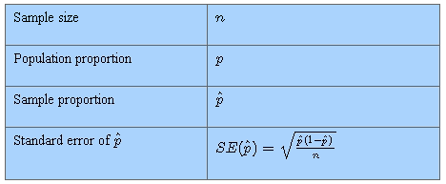
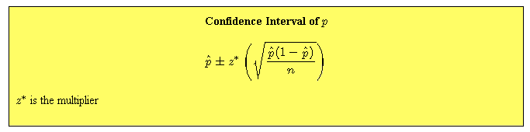
Confidence Interval
Confidence Intervals for Proportions
Assume both np≥10 and n(1−p)≥10. If p is unknown, use pˆ as an estimate of p.
A confidence interval for a populaton proportion is constructed by taking the point estimate (pˆ) plus and minus the margin of error. The margin of error is computed by multiplying a z multiplier by the standard error, SE(pˆ).

Slide 28
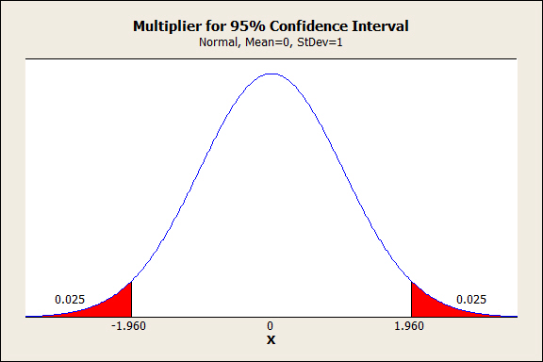
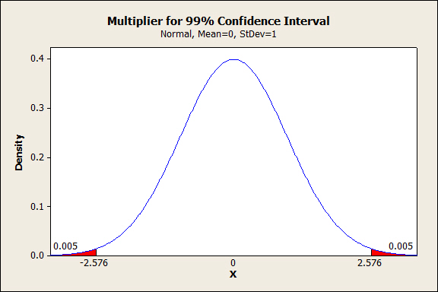
Confidence Interval

Slide 29
Z- T Statistics
Z-TEST / Z-STATISTIC: used to test hypotheses about µ when the population standard deviation is known
– and population distribution is normal or sample size is large.
T-TEST / T-STATISTIC: used to test hypotheses about µ when the population standard deviation is unknown
– Technically, requires population distributions to be normal,
but is robust with departures from normality
– Sample size can be small
The only difference between the z- and t-tests is that the t-statistic estimates standard error by using the sample standard deviation, while the z-statistic utilizes the population standard deviation

Slide 31
Degrees of Freedom

Slide 36
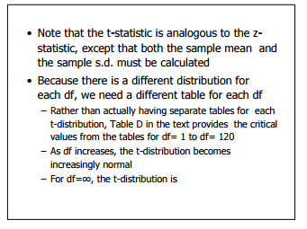

Slide 37
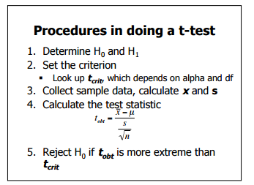

Slide 38

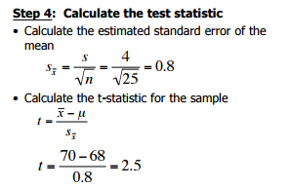
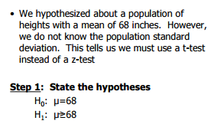
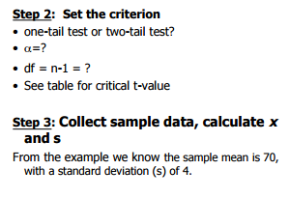
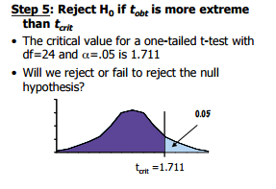

Slide 39
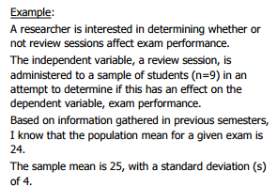

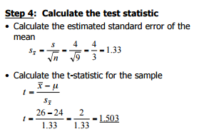
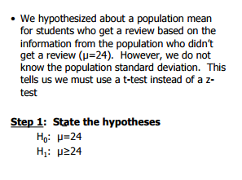
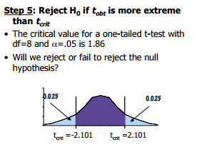
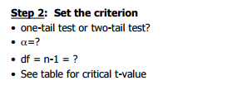

Slide 40
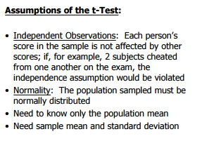
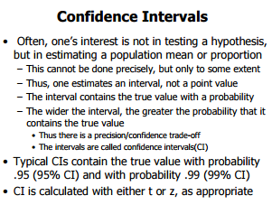

Slide 41
Making Sense of the Two-Sample T-Test
The two-sample t-test is one of the most commonly used hypothesis tests in Six Sigma work. It is applied to compare whether the average difference between two groups is really significant or if it is due instead to random chance. It helps to answer questions like whether the average success rate is higher after implementing a new sales tool than before or whether the test results of patients who received a drug are better than test results of those who received a placebo.
Here is an example starting with the absolute basics of the two-sample t-test. The question being answered is whether there is a significant (or only random) difference in the average cycle time to deliver a pizza from Pizza Company A vs. Pizza Company B. This is the data collected from a sample of deliveries of Company A and Company B.

Slide 42
P -Value
When you perform a hypothesis test in statistics, a p-value helps you determine the significance of your results. Hypothesis tests are used to test the validity of a claim that is made about a population. This claim that’s on trial, in essence, is called the null hypothesis.
The alternative hypothesis is the one you would believe if the null hypothesis is concluded to be untrue. The evidence in the trial is your data and the statistics that go along with it. All hypothesis tests ultimately use a p-value to weigh the strength of the evidence (what the data are telling you about the population). The p-value is a number between 0 and 1 and interpreted in the following way:
A small p-value (typically ≤ 0.05) indicates strong evidence against the null hypothesis, so you reject the null hypothesis.
A large p-value (> 0.05) indicates weak evidence against the null hypothesis, so you fail to reject the null hypothesis.
p-values very close to the cutoff (0.05) are considered to be marginal (could go either way). Always report the p-value so your readers can draw their own conclusions.

Slide 43
P –Value cont..
We wish to test a null hypothesis against an alternative hypothesis using a dataset. The two hypotheses specify two statistical models for the process that produced the data. The alternative hypothesis is what we expect to be true if the null hypothesis is false. We cannot prove that the alternative hypothesis is true but we may be able to demonstrate that the alternative is much more plausible than the null hypothesis given the data. This demonstration is usually expressed in terms of a probability (a P-value) quantifying the strength of the evidence against the null hypothesis in favour of the alternative.
We ask whether the data appear to be consistent with the null hypothesis or whether it is unlikely that we would obtain data of this kind if the null hypothesis were true, assuming that at least one of the two hypotheses is true. We address this question by calculating the value of a test statistic, i.e., a particular real-valued function of the data. To decide whether the value of the test statistic is consistent with the null hypothesis, we need to know what sampling variability to expect in our test statistic if the null hypothesis is true. In other words, we need to know the null distribution, the distribution of the test statistic when the null hypothesis is true. In many applications, the test statistic is defined so that its null distribution is a “named” distribution for which tables are widely accessible; e.g., the standard normal distribution, the Binomial distribution with n = 100 and p = 1/2, the t distribution with 4 degrees of freedom, the chi-square distribution with 23 degrees of freedom, the F distribution with 2 and 20 degrees of freedom.

Slide 44
P –Value cont..
Now, given the value of the test statistic (a number), and the null distribution of the test statistic (a theoretical distribution usually represented by a probability density), we want to see whether the test statistic is in the middle of the distribution (consistent with the null hypothesis) or out in a tail of the distribution (making the alternative hypothesis seem more plausible). Sometimes we will want to consider the right-hand tail, sometimes the left-hand tail, and sometimes both tails, depending on how the test statistic and alternative hypothesis are defined. Suppose that large positive values of the test statistic seem more plausible under the alternative hypothesis than under the null hypothesis. Then we want a measure of how far out our test statistic is in the right-hand tail of the null distribution. The P-value provides a measure of this distance. The P-value (in this situation) is the probability to the right of our test statistic calculated using the null distribution. The further out the test statistic is in the tail, the smaller the P-value, and the stronger the evidence against the null hypothesis in favor of the alternative.

